Slide 1
AAOS
Automated Academic Organization System

Slide 2
Introduction
Automated Academic Organization System (AAOS) is the automated information system featured collectively with content management system, automated data-driven systems and data-analysis system.
This information system is useful for every academic institutions as it provides centralized information of all the stakeholders and helps in decision making from appropriate visualization of institutions’ data.

Slide 3
Overview of the project
This complete system is designed to address the traditional problems in an educational institution. The three major parts of the system are content management system, automated information system and data-analysis system.

Slide 4
Justification of the project
This software provides digital features for all the stakeholders including the business stakeholders, academic staffs, pupils in the educational institutions.
This information system will appropriately centralize the voluminous data of the educational institution by using the digital technology instead of traditional method.

Slide 5
Aims and Objectives
A centralized and robust information system that can manage the educational sectors and provide convenient way to perform transactions.
Computerize the transactions in an educational institution.
Visually represent the information of different sectors in an organization.
Automate trivial activities related to a particular transaction or activity.

Slide 6
Analysis Methodology
The preferred analysis methodology is Object Oriented Analysis (OOA)
In OOA requirements are organized as objects. It integrates all the process and data.
The common models used in OOA are: Use cases, Object models.
OOA Modellings
Static Modelling
Dynamic / Functional Modelling

Slide 7
Functional Requirements
User Registration
User Login and Authentication
Organization’s details Entry
Organization’s detail Update
View Organization’s details
Organization details Deletion
Student’s CMS
Academic Detail CMS
Data Validation
Centralized Student Information
Access Control
Tabular Representation
Student’s analysis
Student Report Generation
Exam and Lecture notices
E-invoices
Multiple Sessions
Session Management
Intuitive UI

Slide 8
Non-functional Requirements
Access Security
Integrity
Flexibility
Portability
Reliability
Maintainability
Scalability
Availability
Confidentiality
Usability
Efficiency
Interoperability

Slide 9
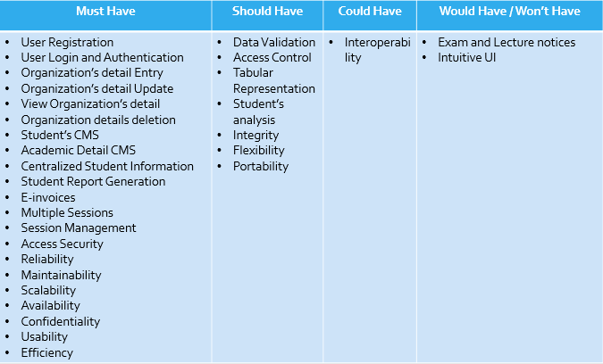
MoSCoW Prioritization

Slide 10
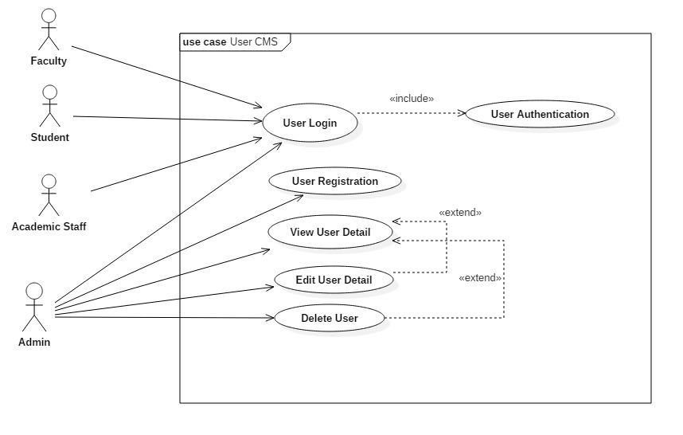
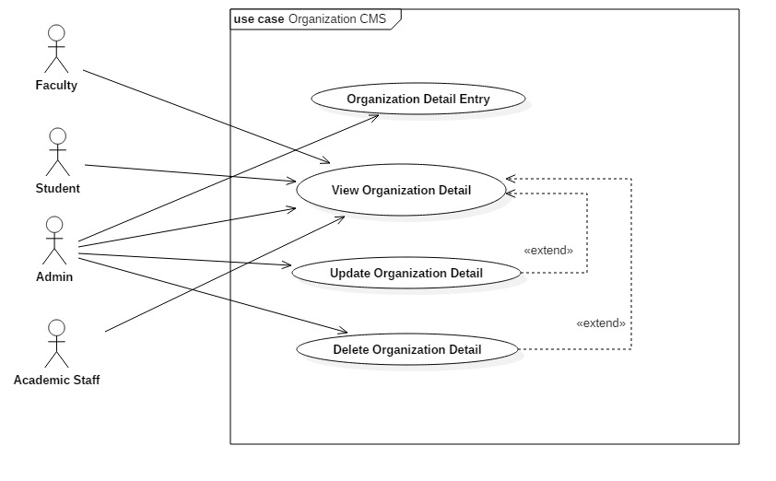
Use-cases-1

Slide 11
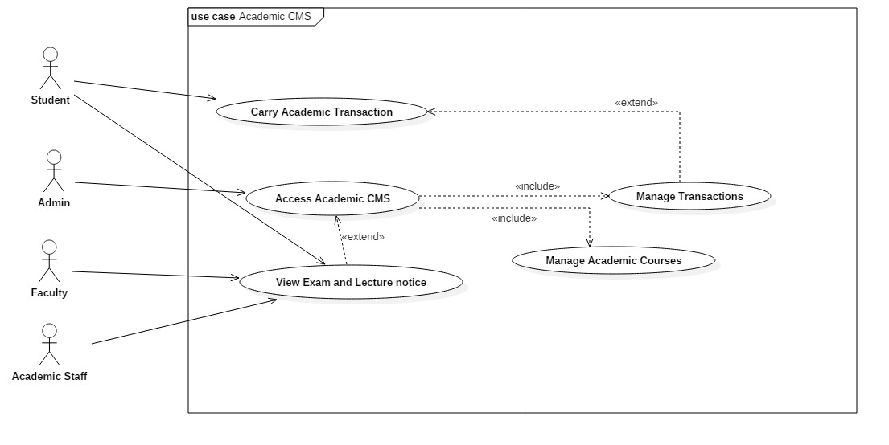
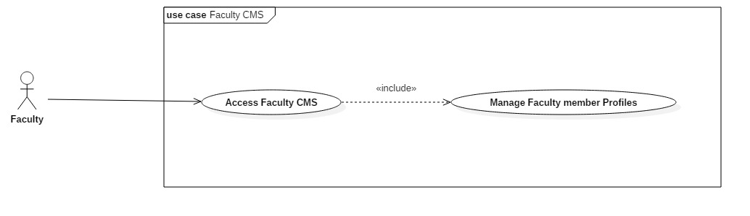
Use-cases-2

Slide 12
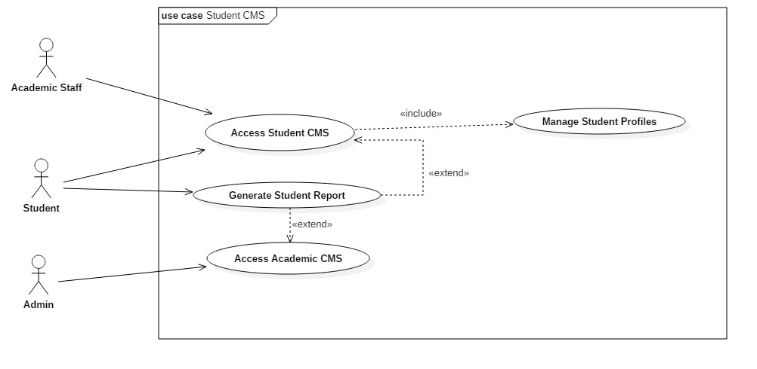
Use-cases-3

Slide 13
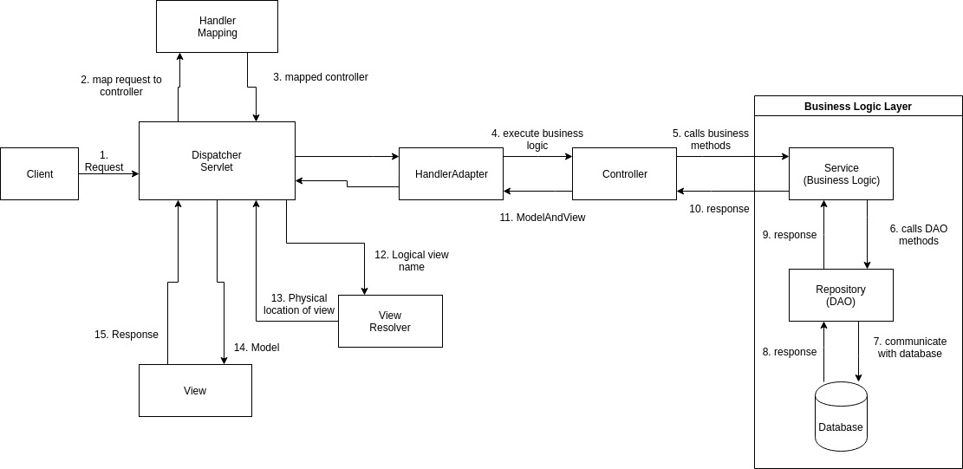
System Architecture

Slide 14
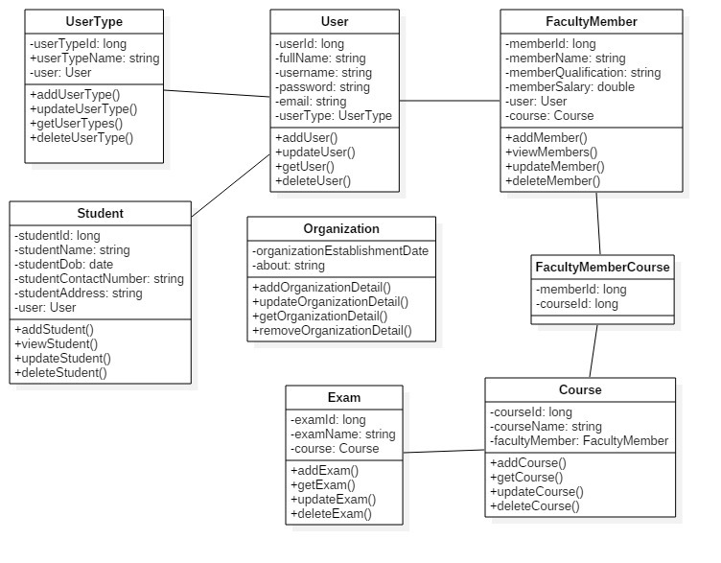
Initial Class Diagram

Slide 15
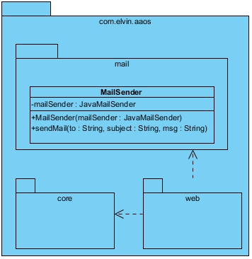
Final Class Diagram-1

Slide 16
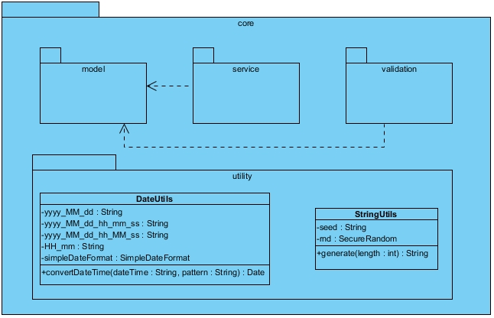
Final Class Diagram-2

Slide 17
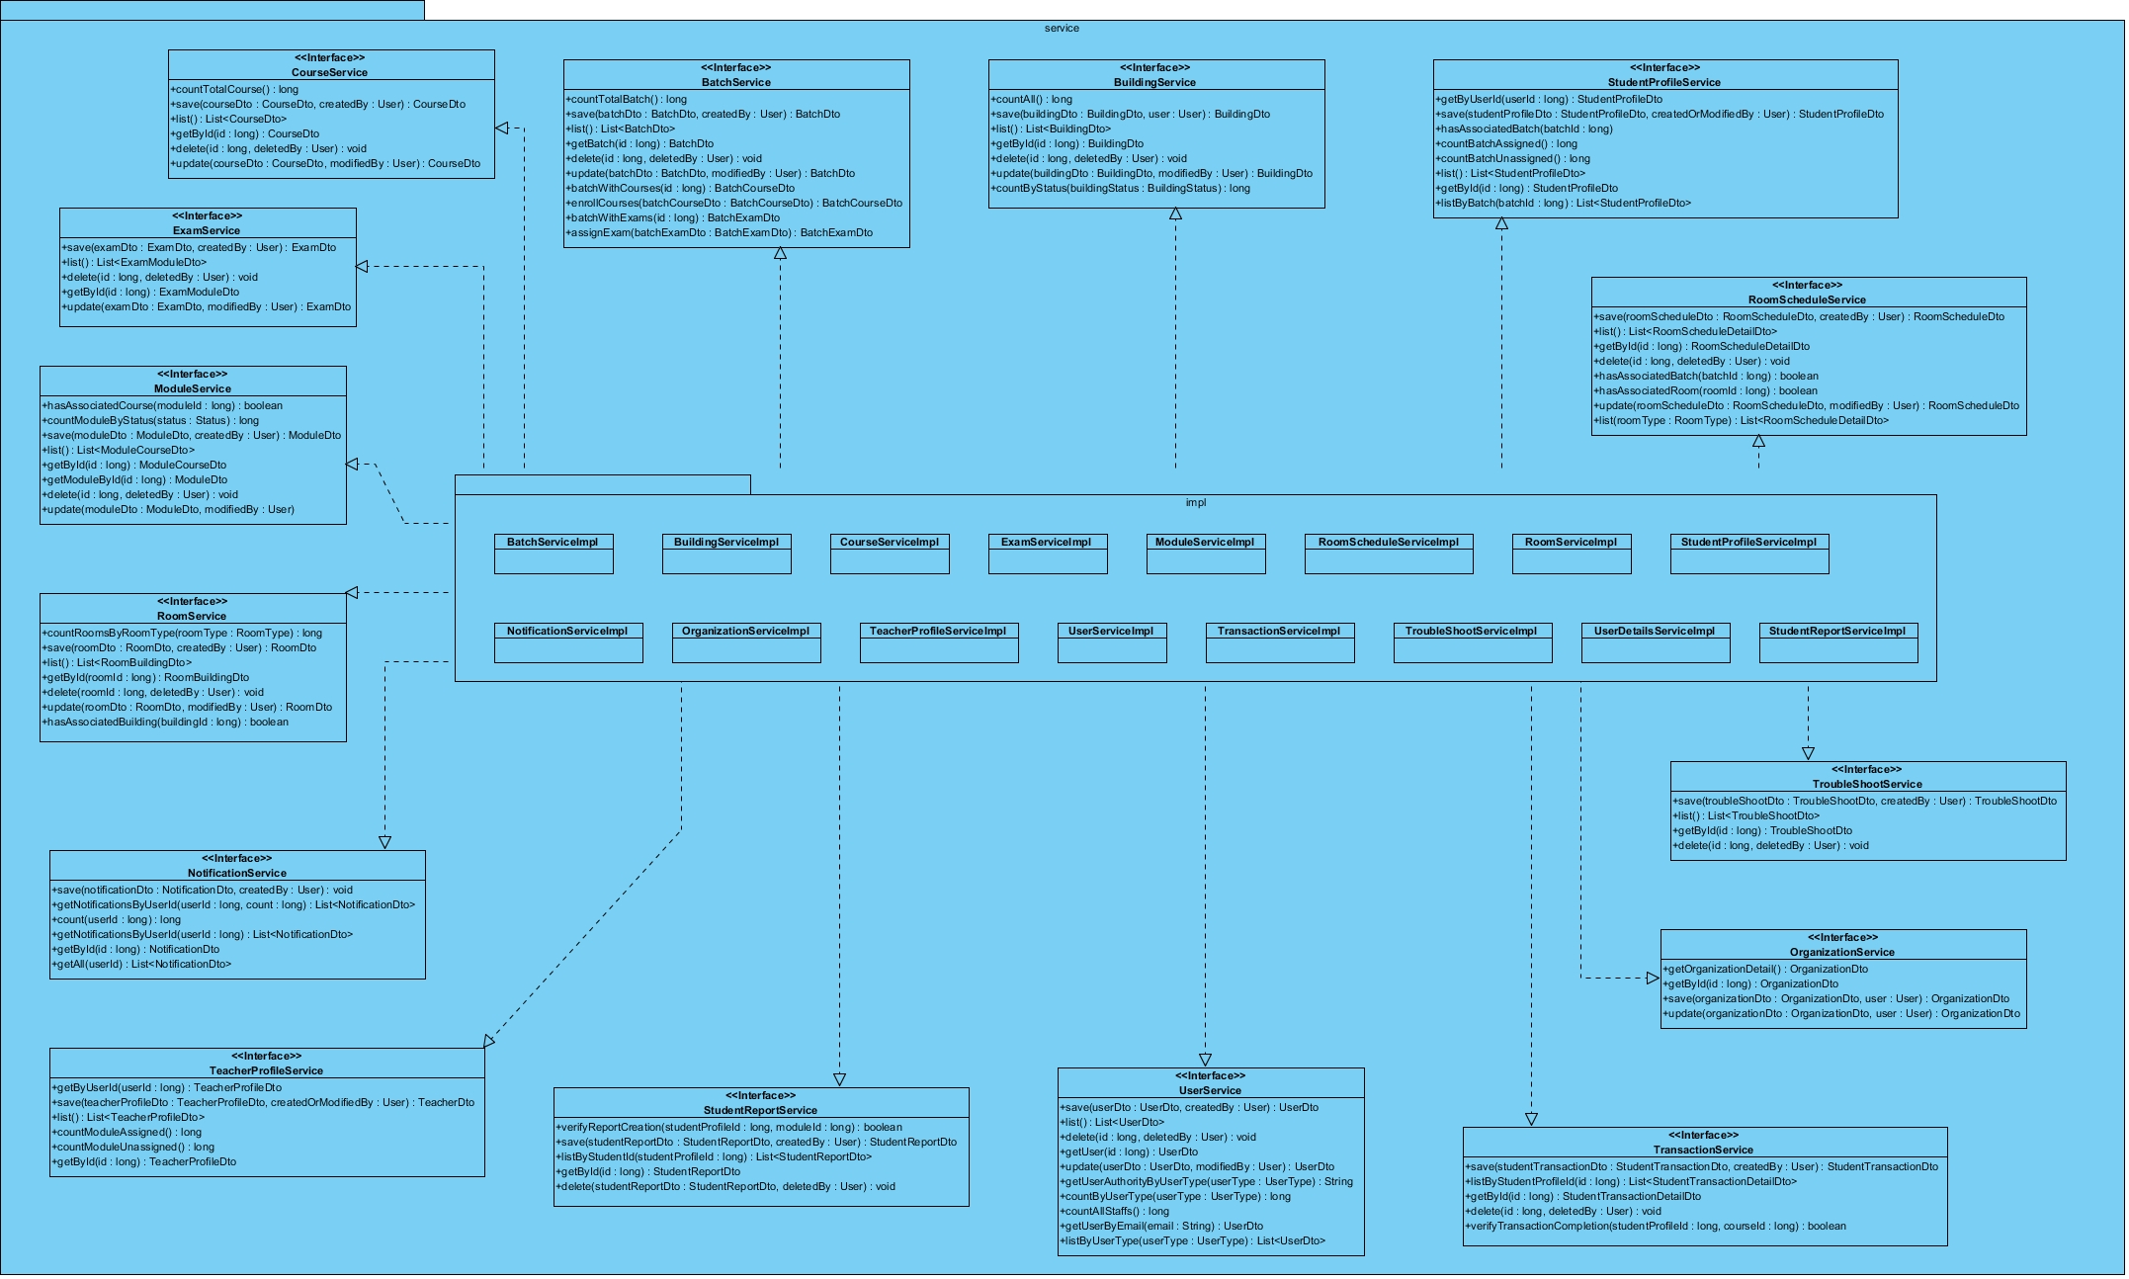
Final Class Diagram-3

Slide 18
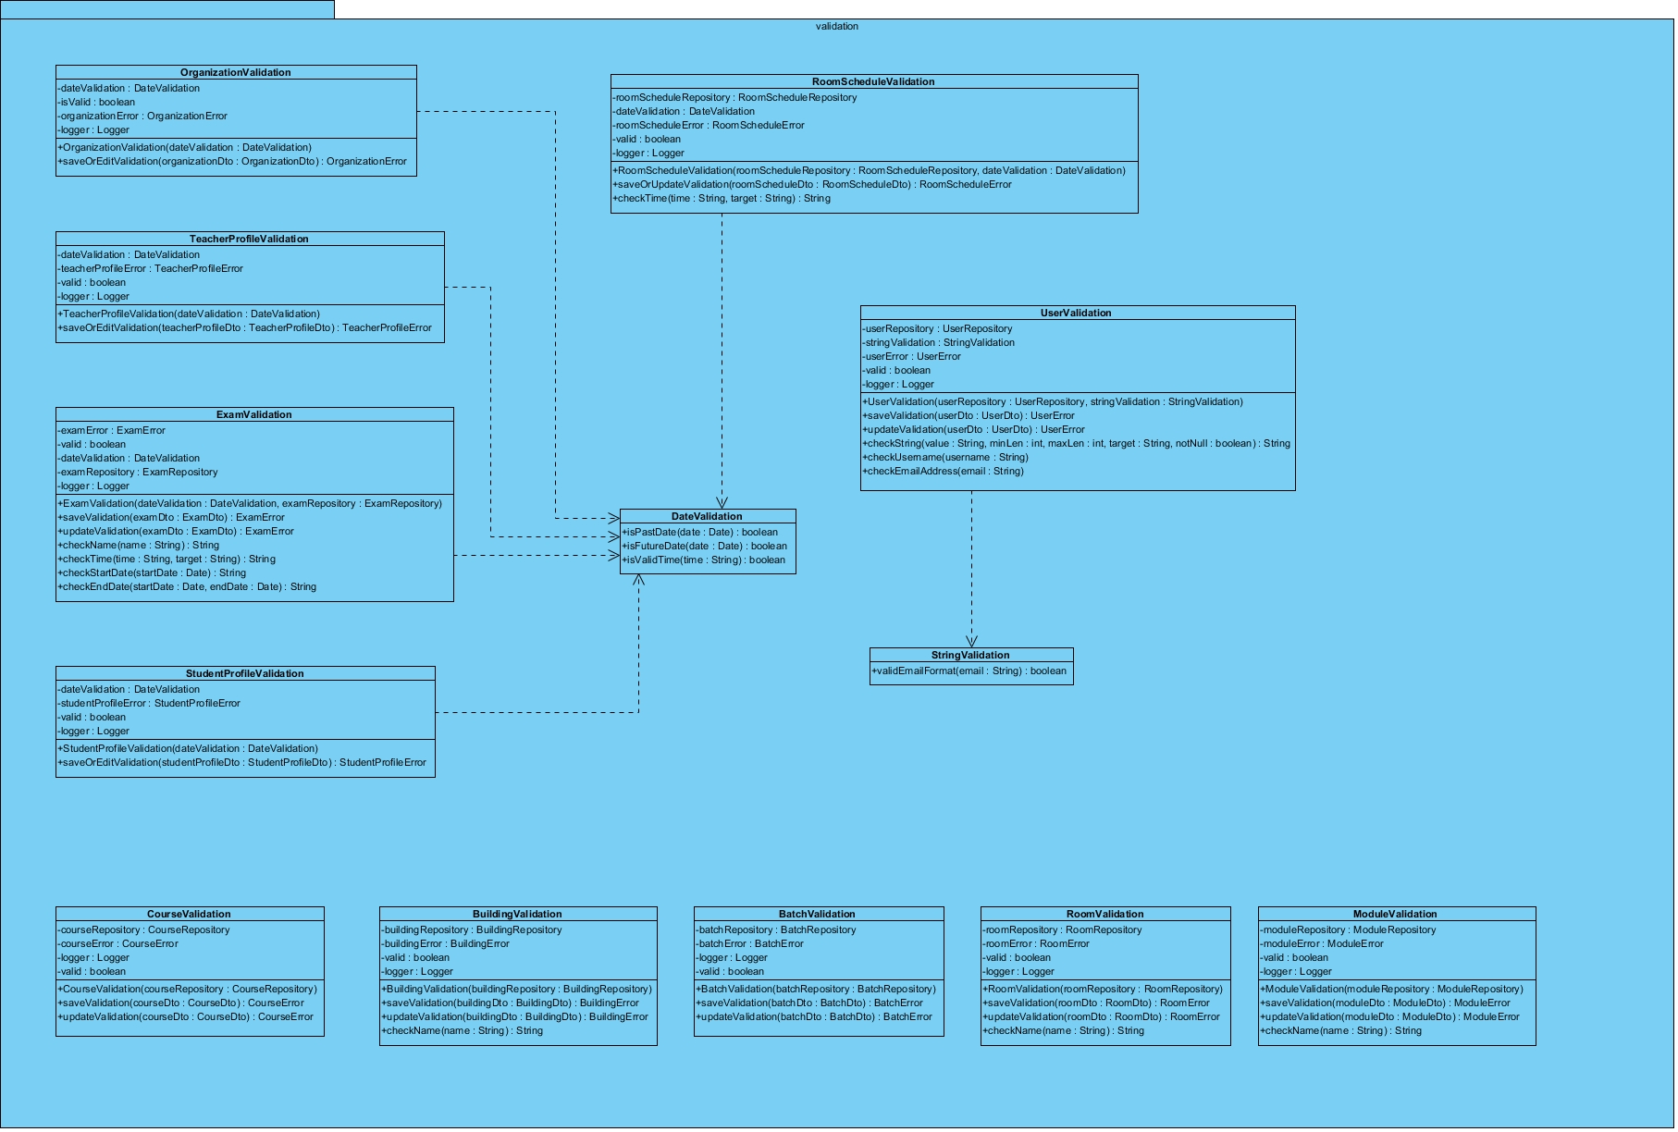
Final Class Diagram-4

Slide 19
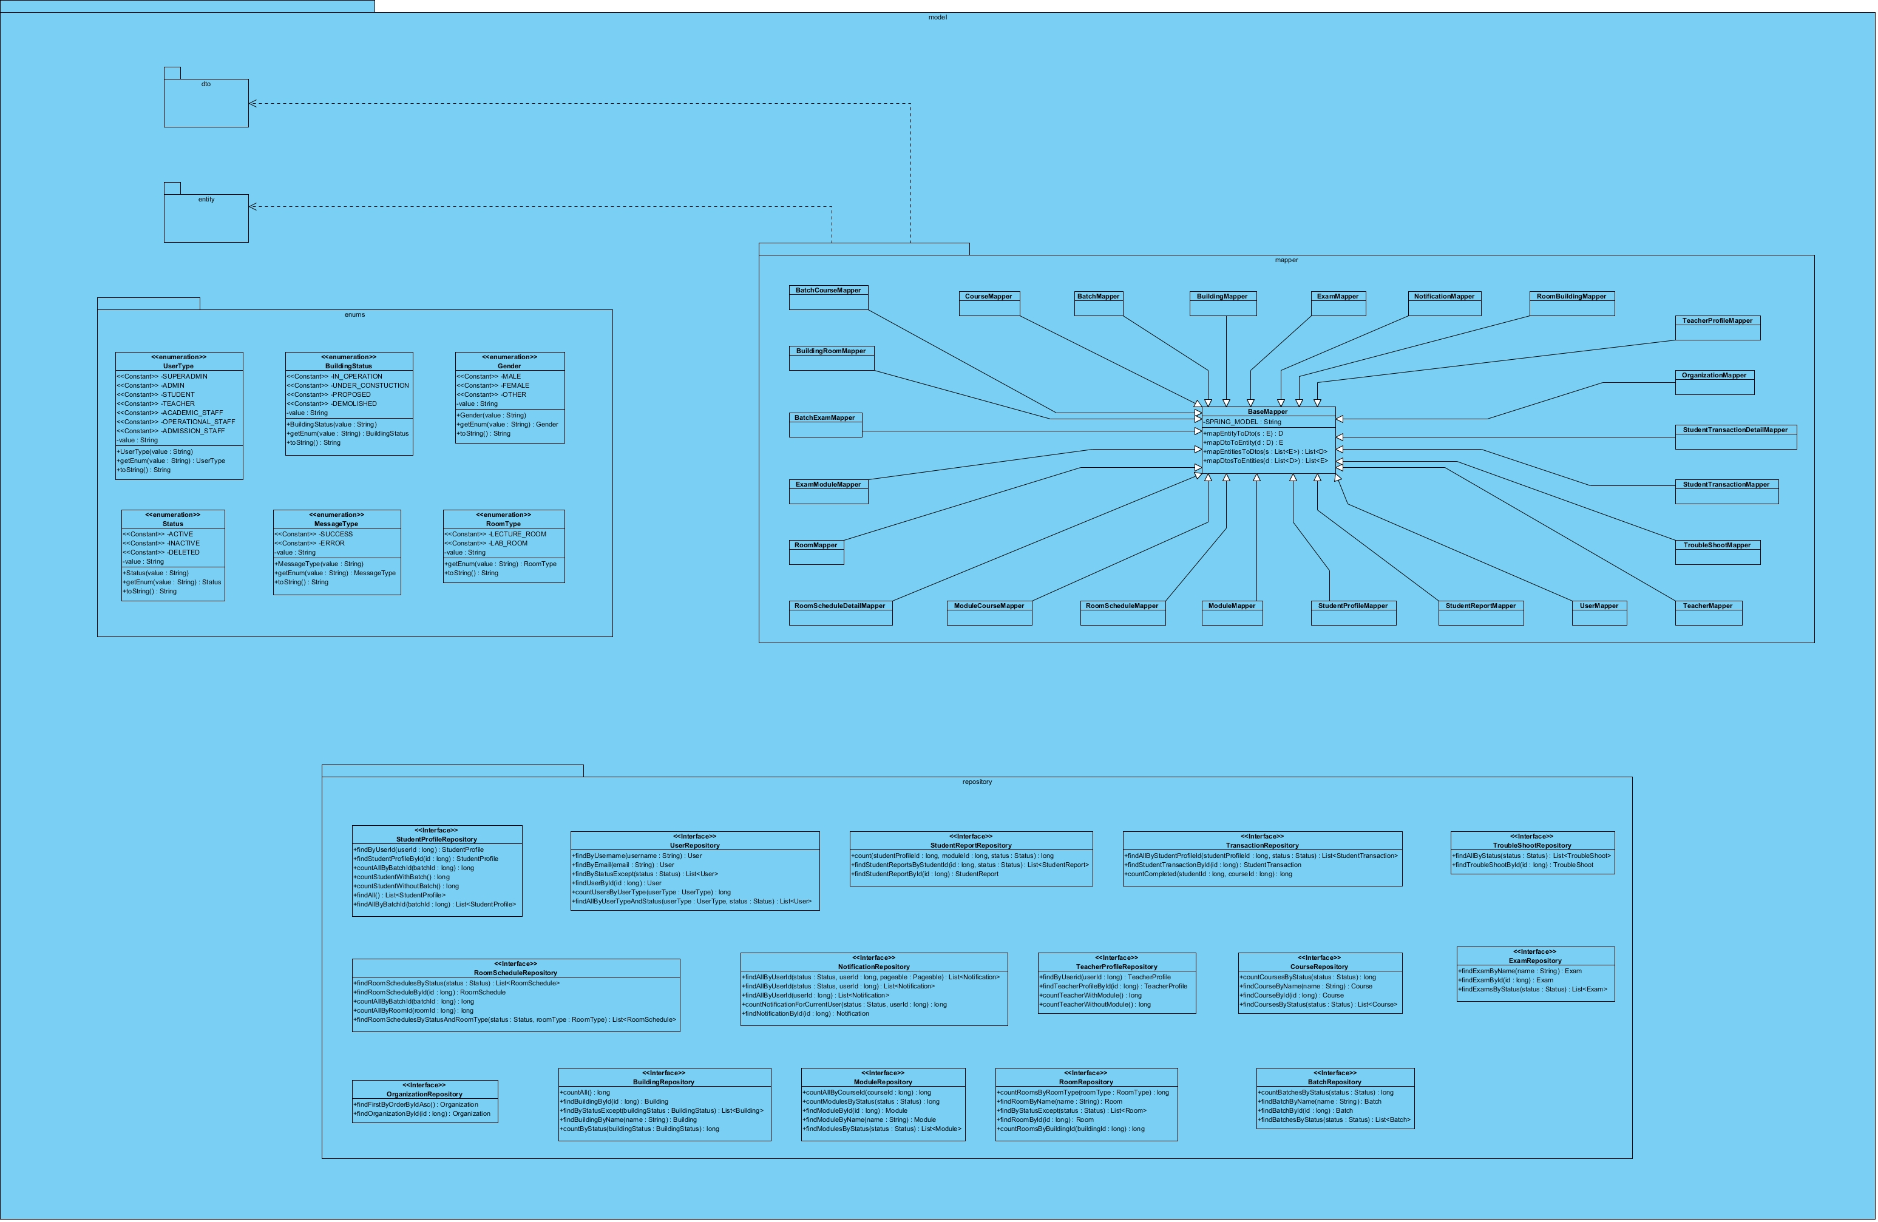
Final Class Diagram-5

Slide 20
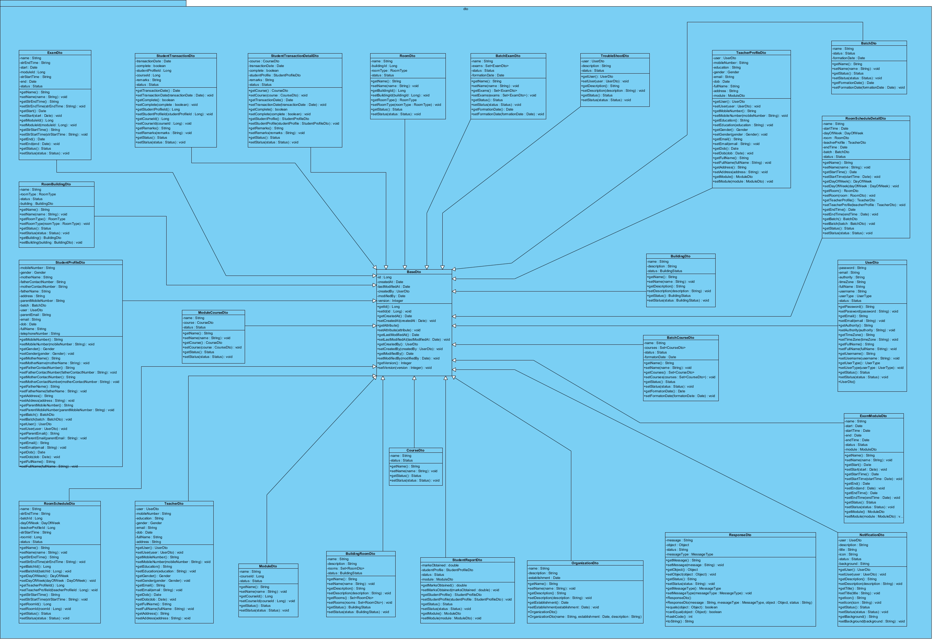
Final Class Diagram-6

Slide 21
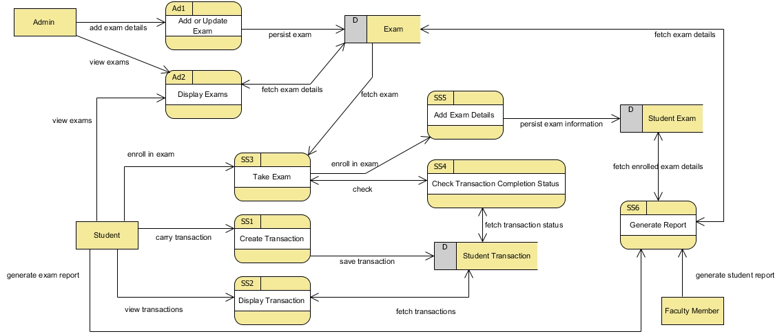
Academic Data Flow Diagram

Slide 22
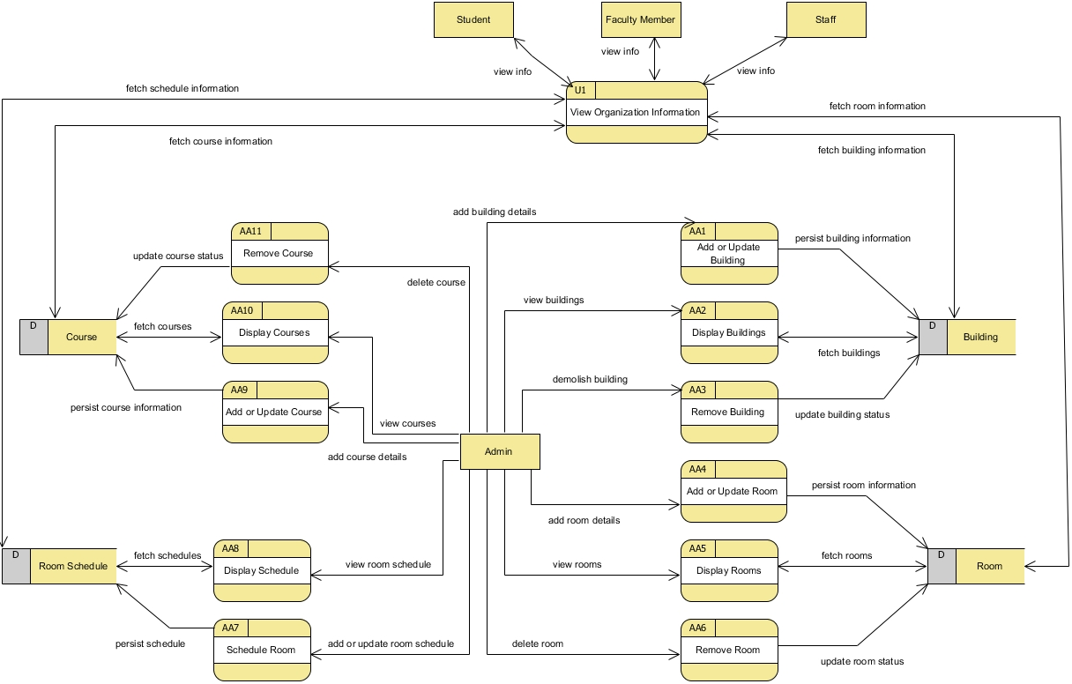
Organization Data Flow Diagram

Slide 23
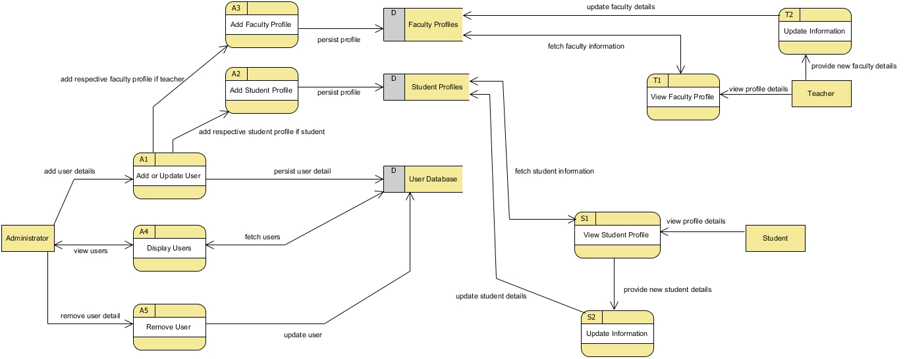
User Profile Data Flow Diagram

Slide 24
User Profile Data Flow Diagram

Slide 25
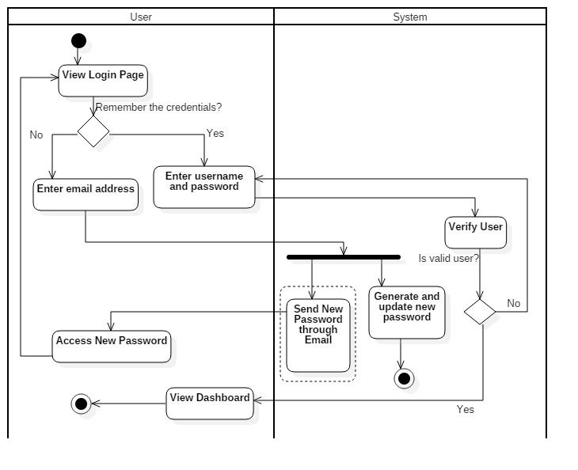
User Login Activity Diagram

Slide 26
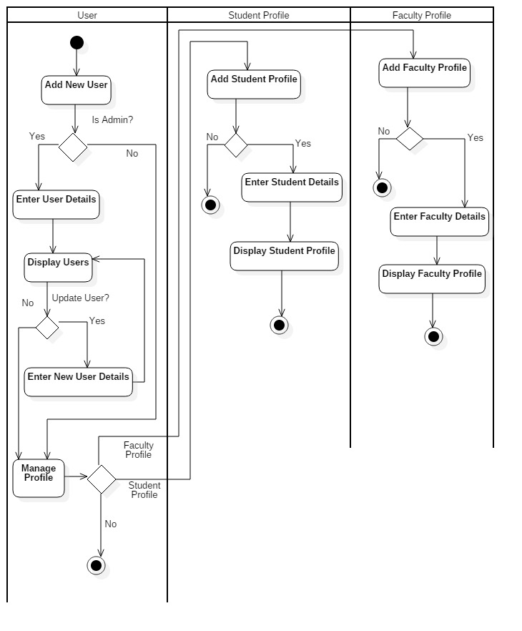
User Profile Management Activity Diagram

Slide 27
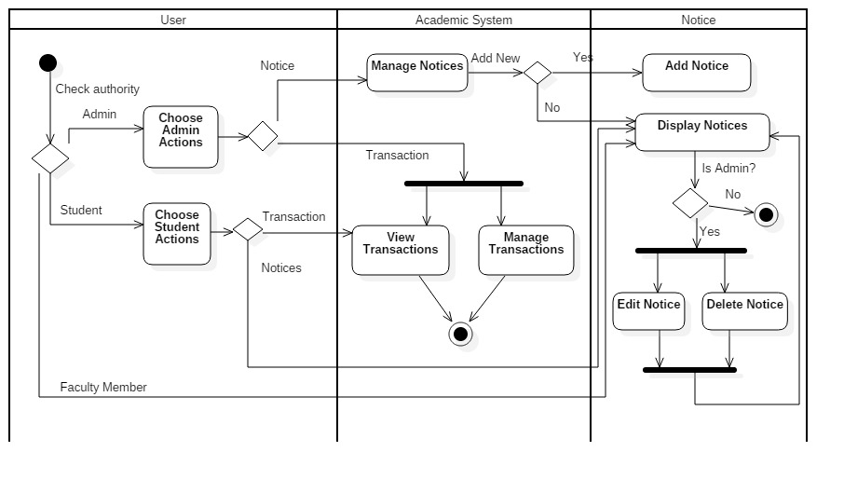
Academic Operation Activity Diagram

Slide 28
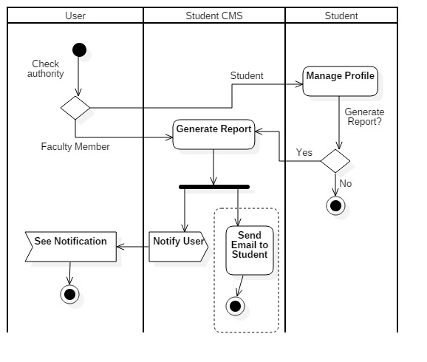
Student CMS Activity Diagram

Slide 29
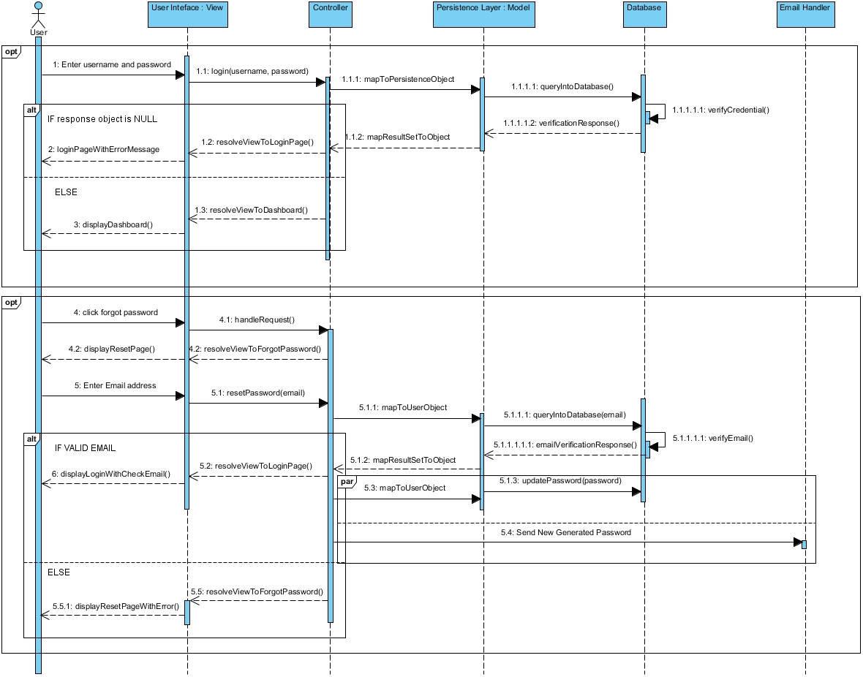
Login Sequence Diagram

Slide 30
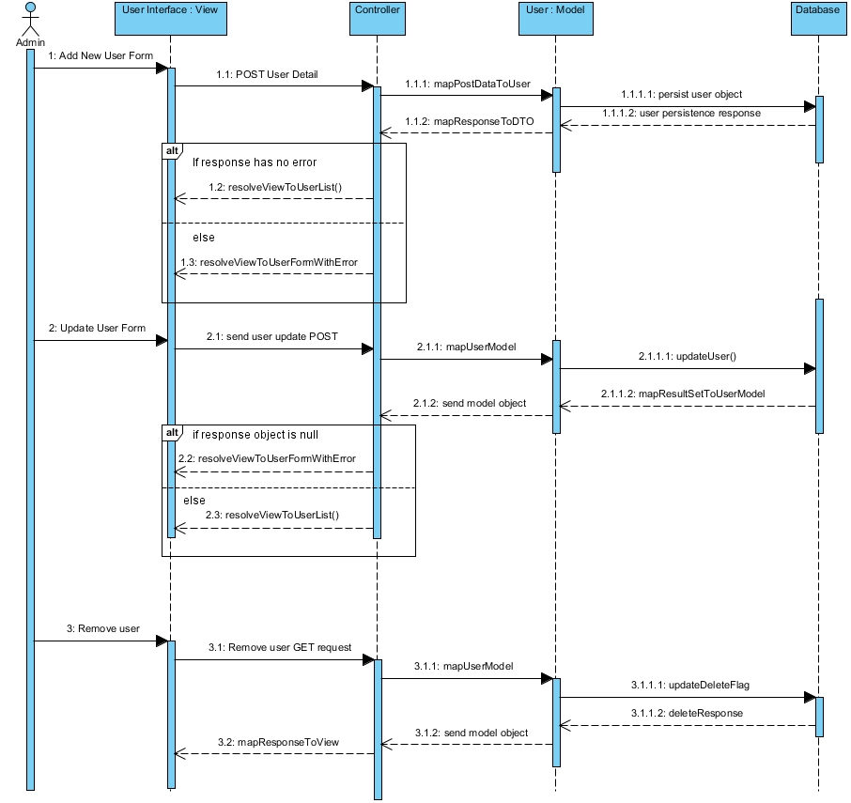
User Sequence Diagram

Slide 31
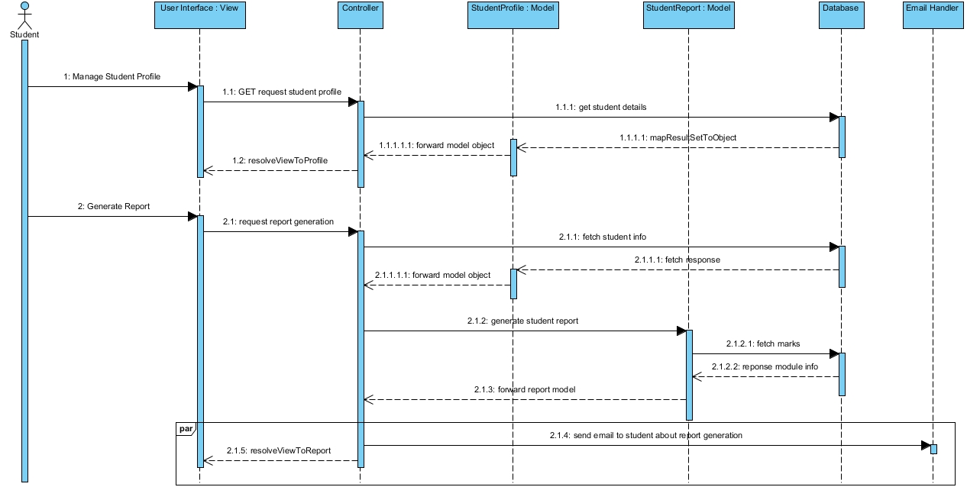
Student Sequence Diagram

Slide 32
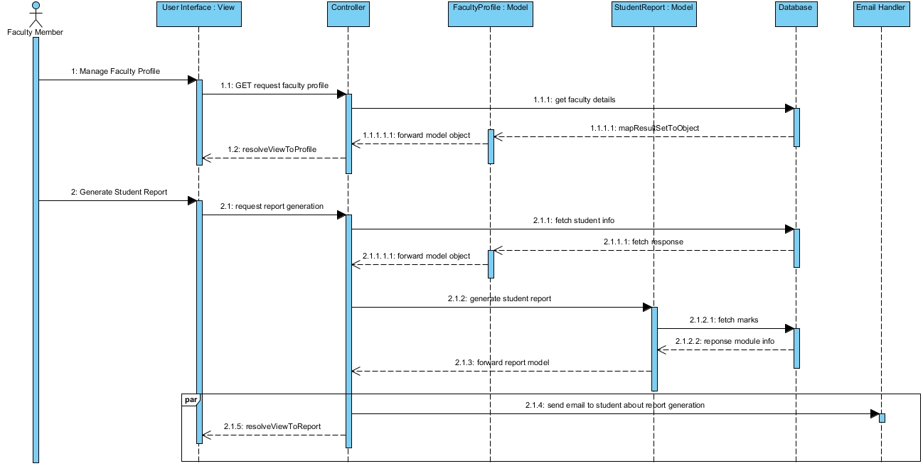
Faculty Sequence Diagram

Slide 33
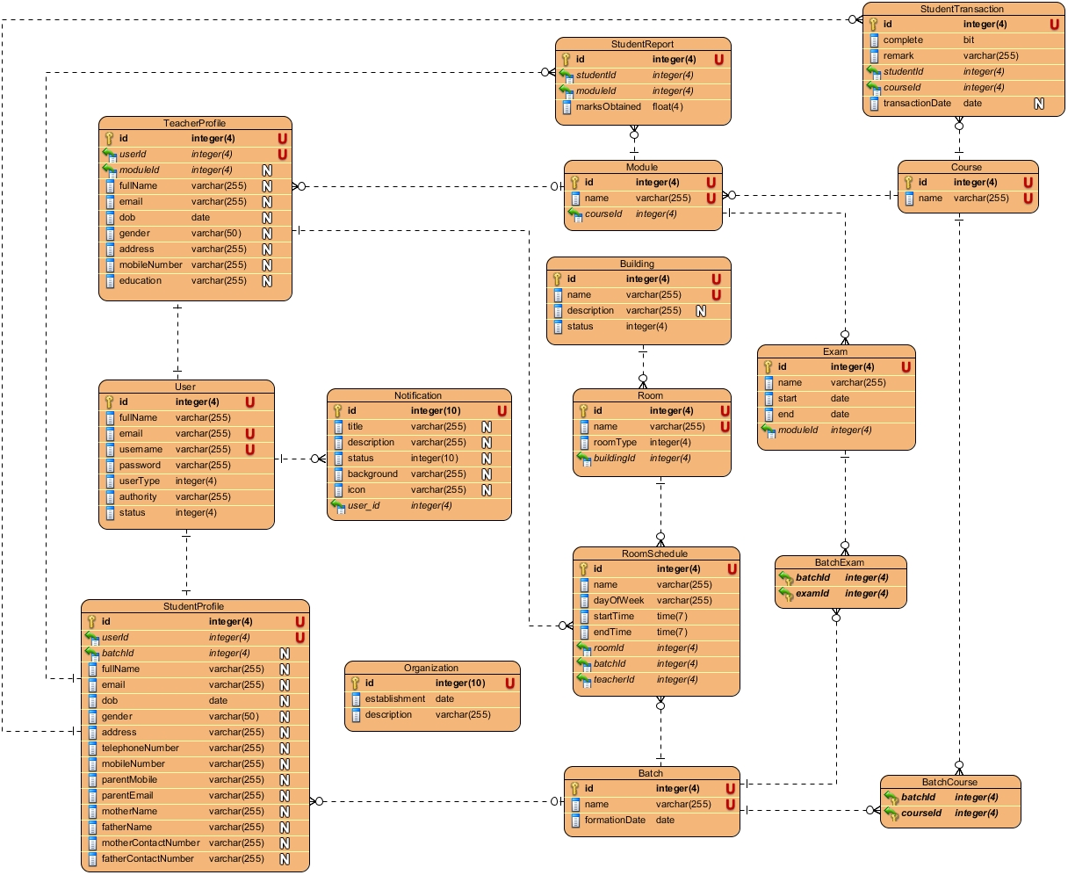
Entity Relationship Diagram

Slide 34
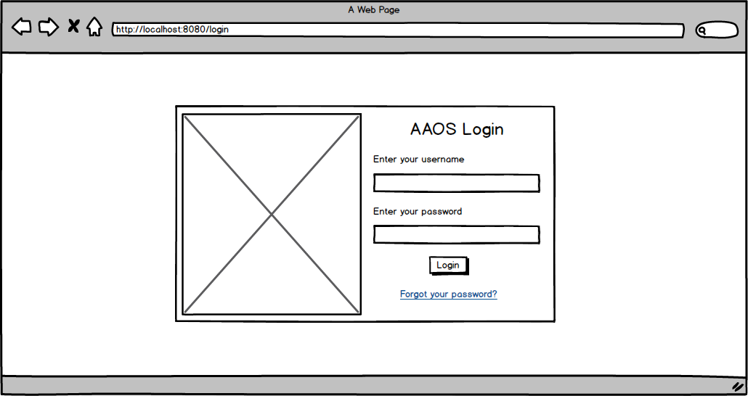
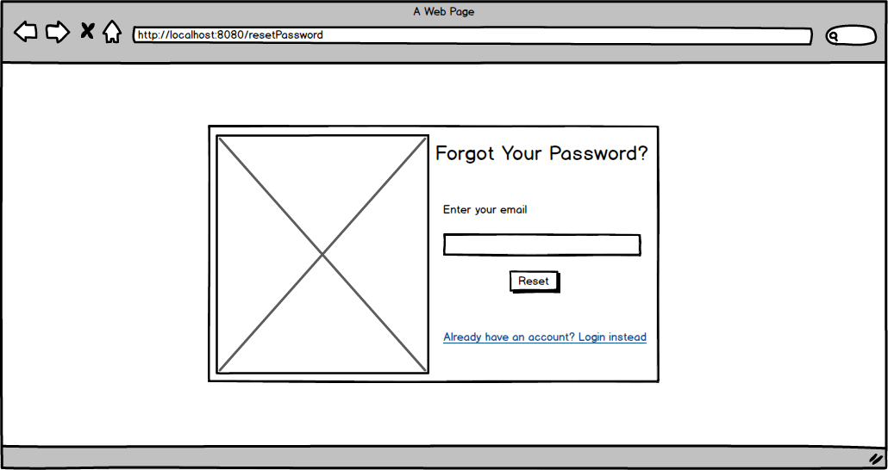
User Interface Modelling-1

Slide 35
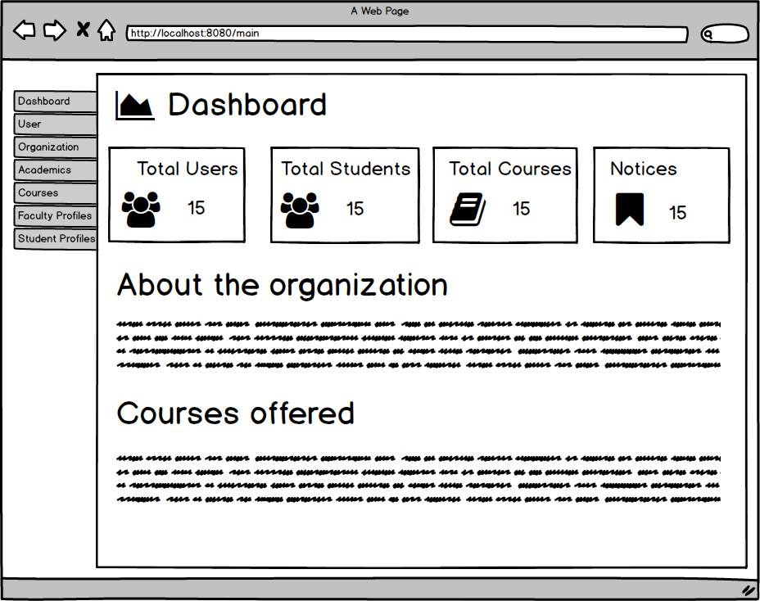
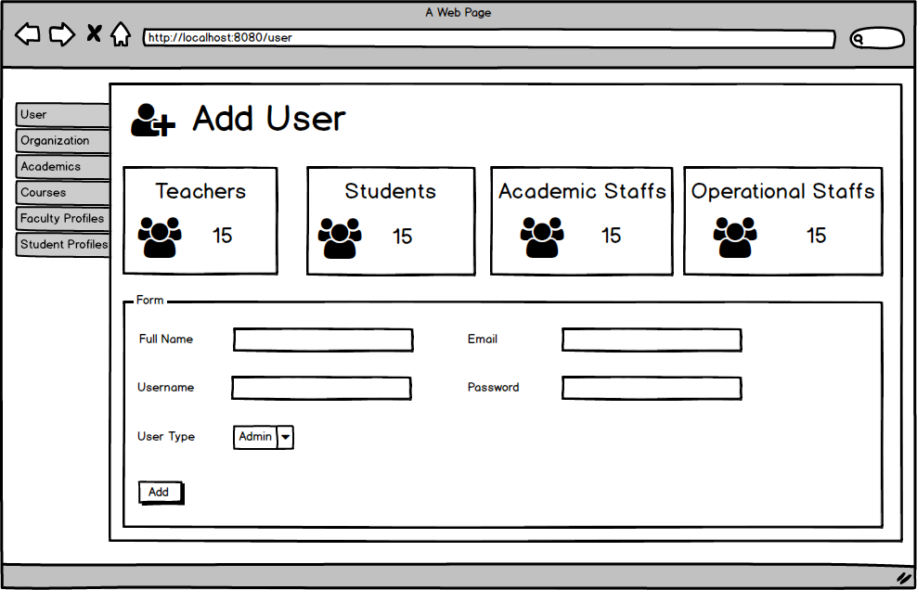
User Interface Modelling-2

Slide 36
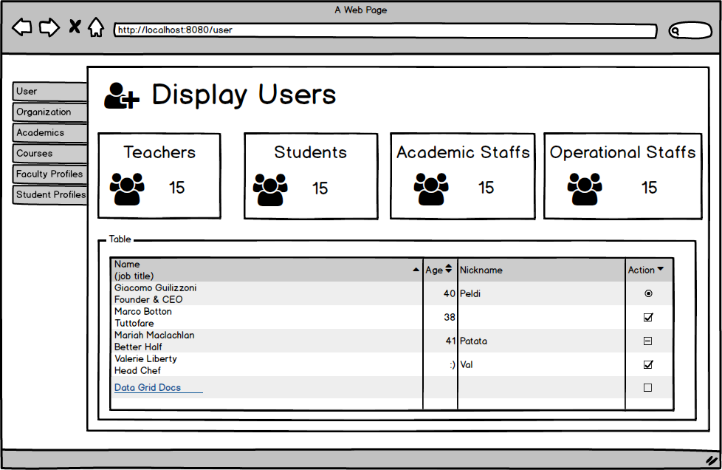
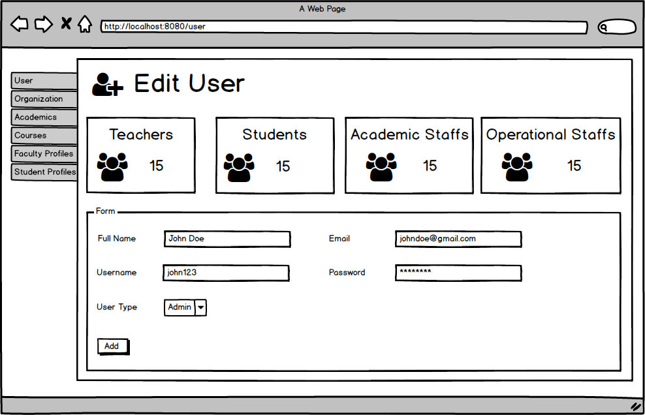
User Interface Modelling-3

Slide 37
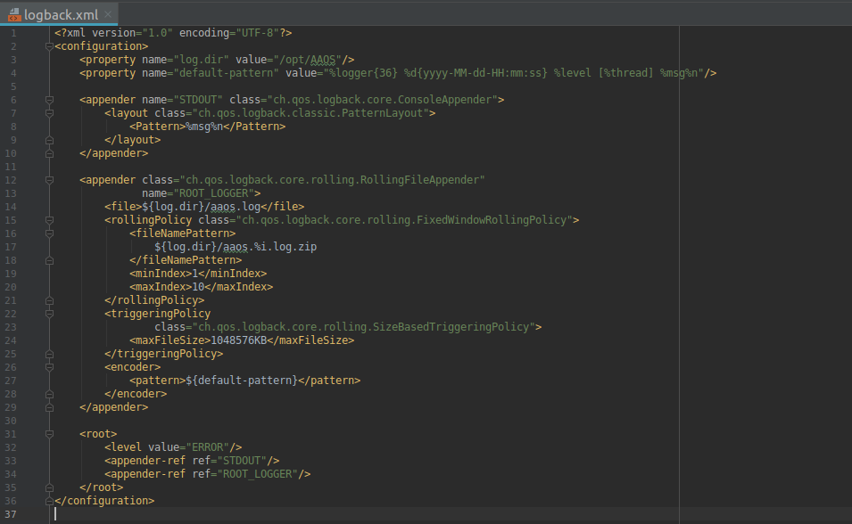
Few Code Snippets

Slide 38
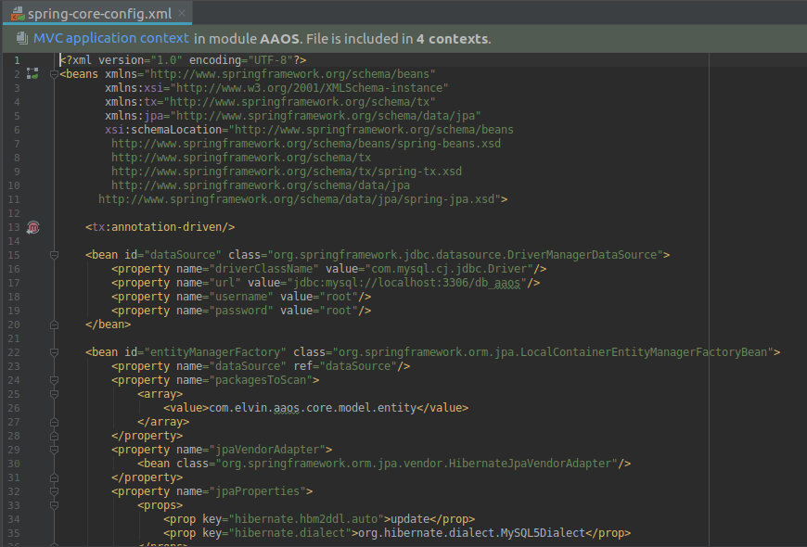
Few Code Snippets

Slide 39
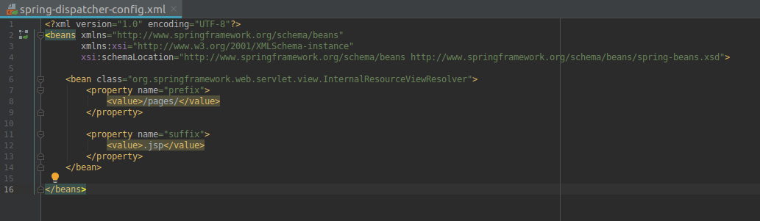
Few Code Snippets

Slide 40
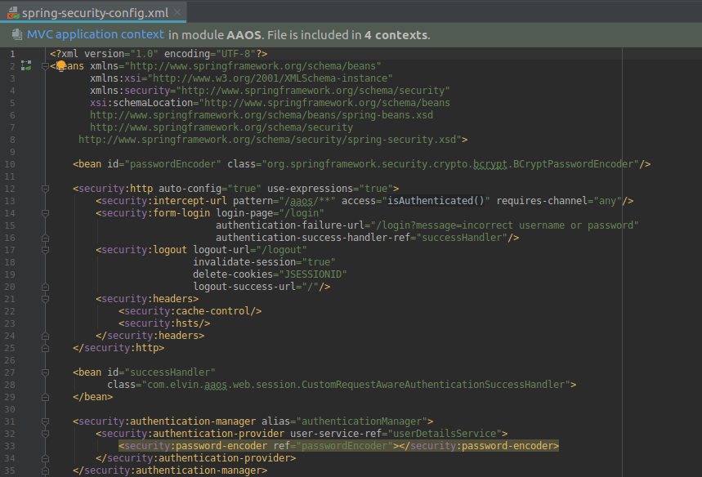
Few Code Snippets

Slide 41
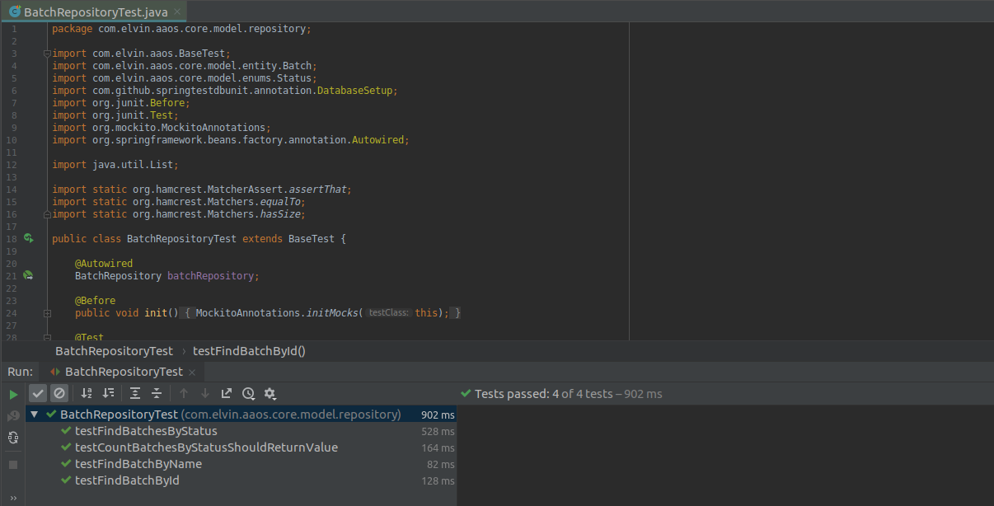
Few Testing Snippets

Slide 42
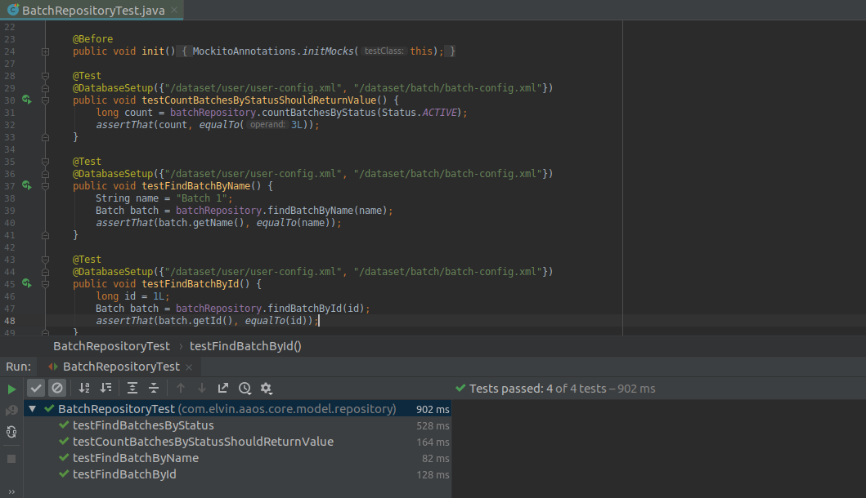
Few Testing Snippets

Slide 43
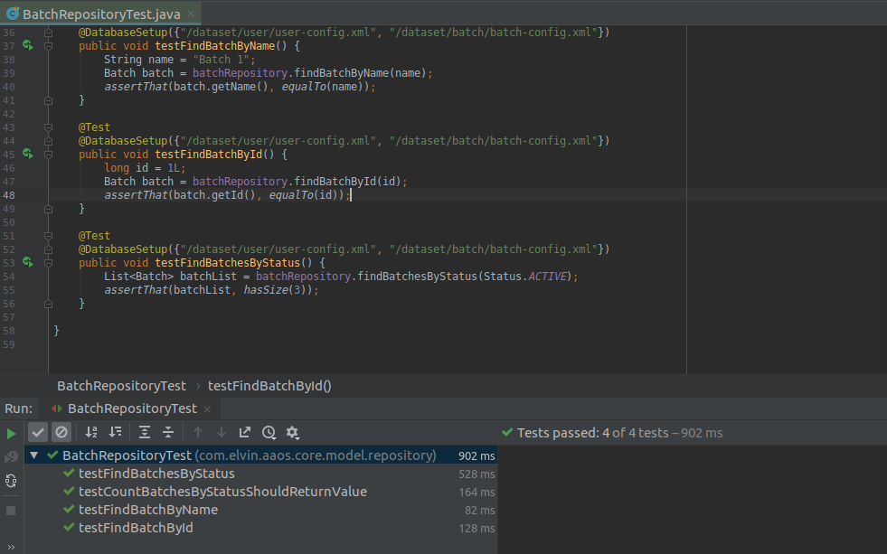
Few Testing Snippets

Slide 44
Future Works
Intensive testing must be performed by testing it in real scenario of the educational organization.
Additional appropriate charts and graphs must be integrated.
Separate transaction module must be created and integrated, and should replace the current one which is very simple.
Notification must be real-time and should be build using web-sockets instead of asynchronous request and response.
Exceptions should not be shown to the user, instead proper exception handling must be done.

Slide 45
Limitations
Use of JSP in spite of emergence of front-end technologies such as Angular framework makes the program to consume more resources because the complete webpage must be reserved by the server when a request is made.
The form templates are not dynamic and this may result in additional work when specific requirement of particular organization is required to meet.

Slide 46
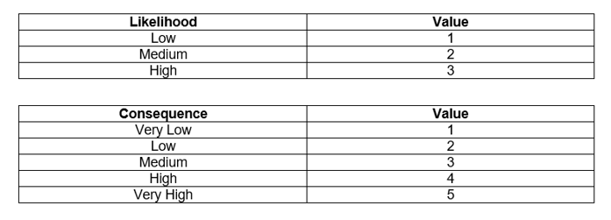
Risk Management

Slide 47
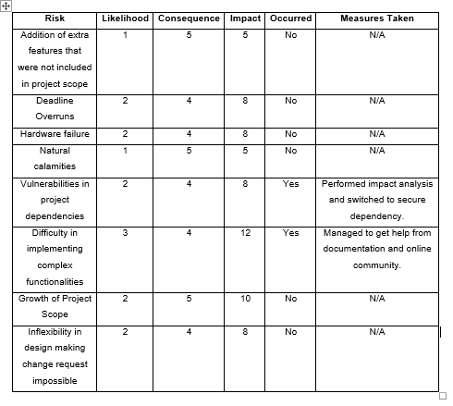
Risk Management

Slide 48
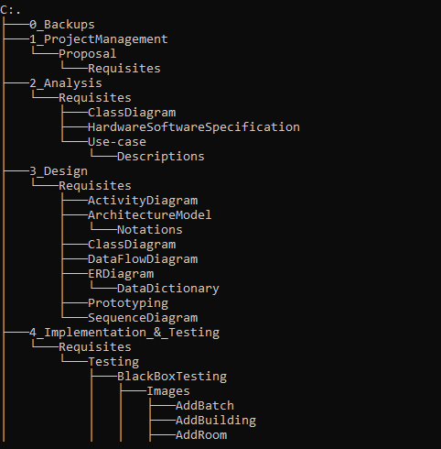
Configuration Management
Project repository: https://github.com/elwyncrestha/aaos

Slide 49
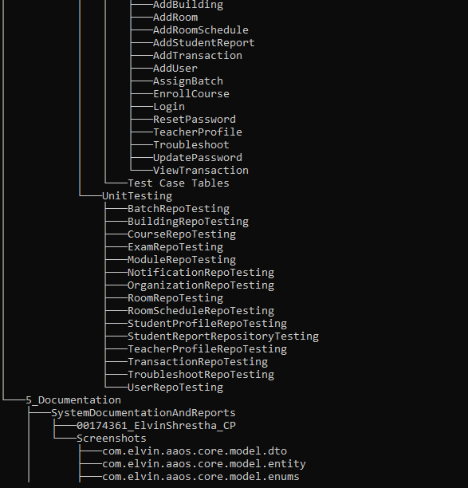
Configuration Management

Slide 50
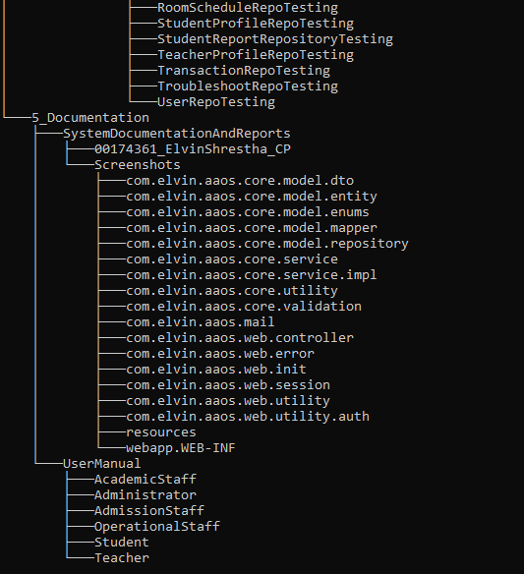
Configuration Management

Slide 51
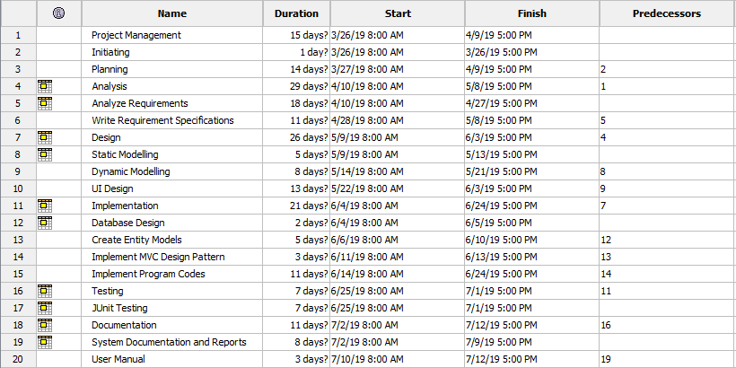
Gantt Chart

Slide 52
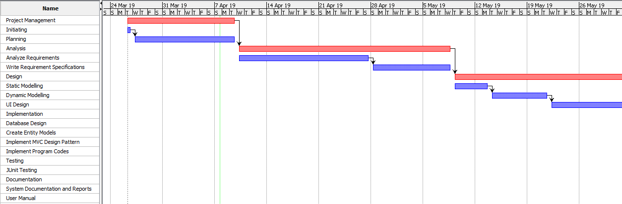
Gantt Chart

Slide 53
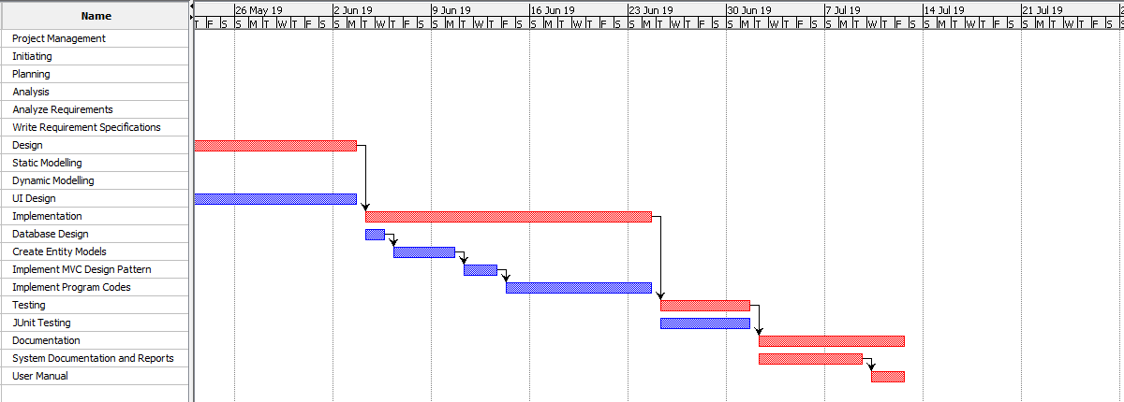
Gantt Chart

Slide 54
Conclusion
The proposed system has been developed with detail implementation of all the software development methodology. All the project features have been developed as per the proposed objectives of the project. The system has been analyzed using OOA Modellings where its application provided the functional and non-functional requirements. Moreover, the system specification has been mentioned for the configuration of the software. Hence, with the appropriate implementation of all software development methodologies, this project has been developed completely meeting all the functional and non-functional requirements mentioned in the requirement specification. This project is applicable in an educational institution.

